Slide 2




$$\hat{v}$$
A
A
$$ρ$$
$$\hat{v}$$
$$ρ$$

Slide 3









P
P
P (dB)
DR_{P}
DR_{T}
DR_{I}
t
t
t
DR_{P}
$$Z_{1}, c_{1}, α_{1}$$
$$p_{1}$$
$$Z_{1}, c_{1}$$
$$Z_{2}, c_{2}$$
$$θ_{11}$$
DR_{I}
$$θ_{21}$$
$$θ_{12}$$
$${p_{3}=TF p}_{1}$$
$${p_{2}= RF p}_{1}$$

Slide 4
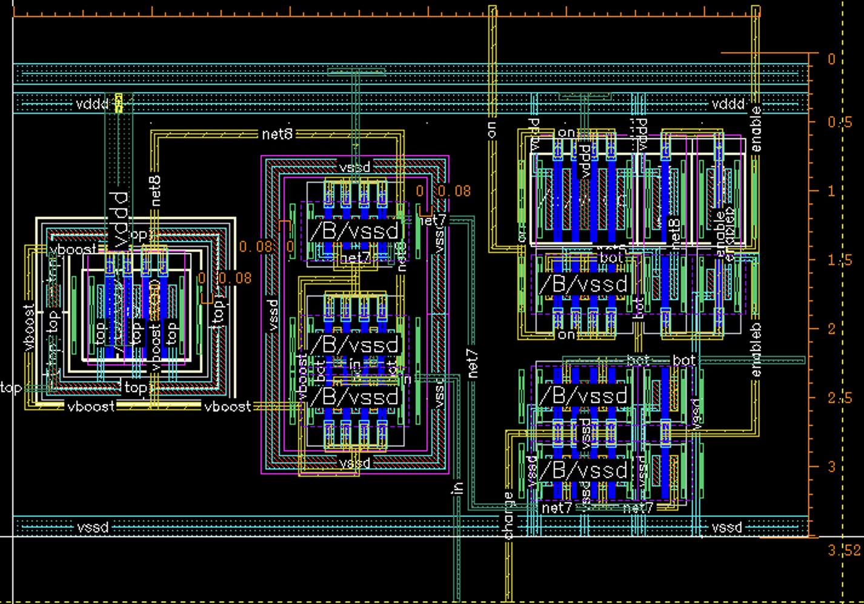
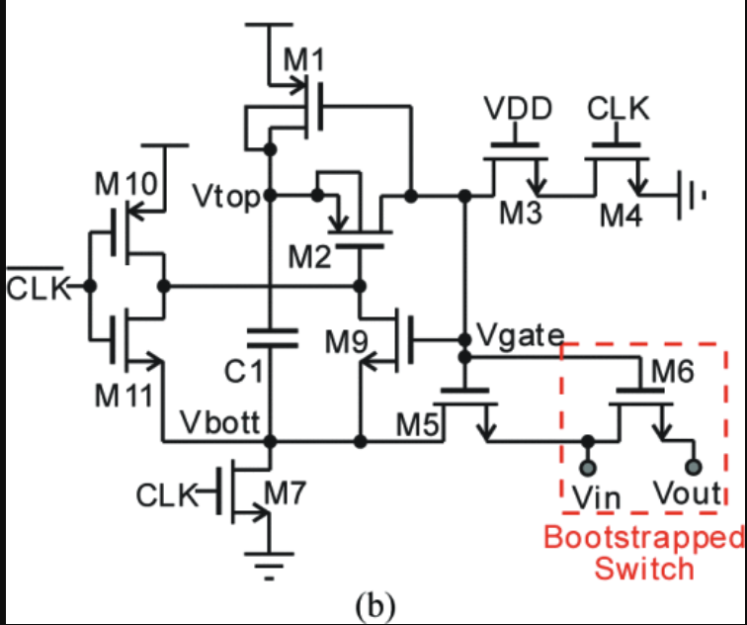
A
B
vboost
A
vin
B

